Slide 1

Cloud Computing: An Overview
Cloud computing has transformed how businesses operate. It offers scalable, reliable, and cost-effective IT solutions. This presentation explores its key concepts. We'll cover service models, deployment options, and security measures. Discover how cloud solutions drive success and innovation.

Slide 2
Defining Key Concepts
On-Demand Resources
Shared Infrastructure
Network Access
Access computing resources anytime. Scale resources based on your current needs.
Multiple users share resources. Optimize utilization and lower costs.
Access services over a network. Use the Internet to reach applications and data.

Slide 3
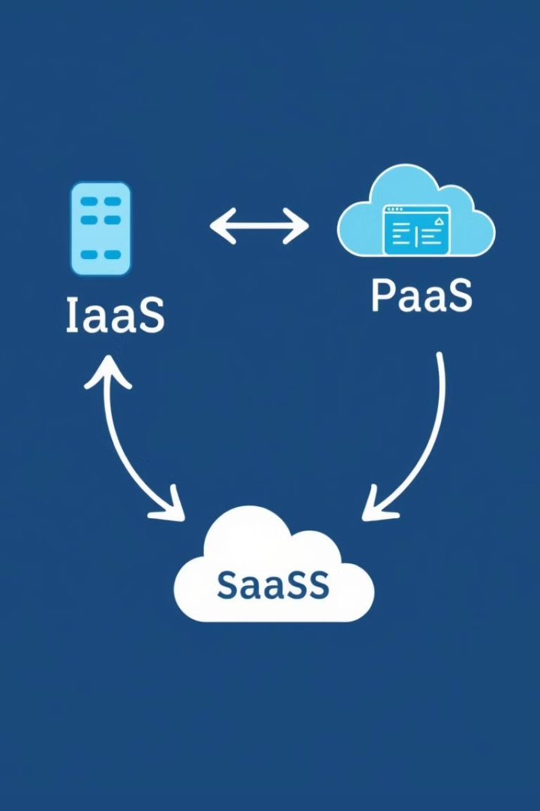
Cloud Service Models
1
IaaS
2
PaaS
Infrastructure as a Service provides computing resources. You manage the OS, storage, and applications.
Platform as a Service delivers a development environment. Build and deploy apps without infrastructure management.
3
SaaS
Software as a Service provides ready-to-use applications. Access software over the Internet, such as Salesforce.

Slide 4
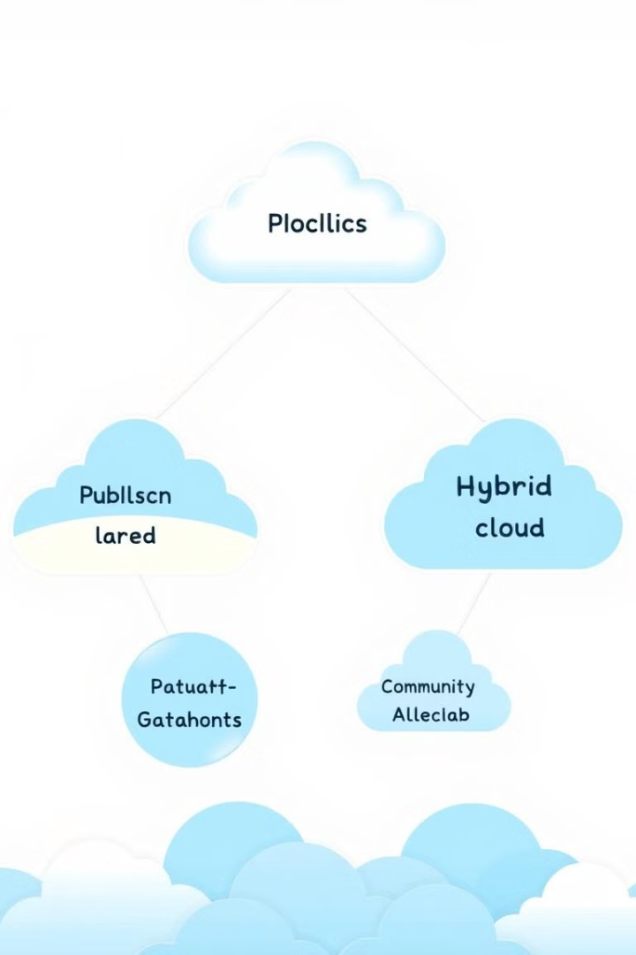




Deployment Models
Public Cloud
Private Cloud
Hybrid Cloud
Shared infrastructure available to the public. Offered by third-party providers.
Infrastructure dedicated to a single organization. Offers greater control and security.
Combines public and private clouds. Allows for flexible resource allocation.
Community Cloud
Shared infrastructure for specific communities. Used by organizations with shared interests.

Slide 5




Benefits of Cloud Computing
Cost Savings
Reduce capital expenditures and operational costs. Pay only for resources you consume.
Scalability
Easily scale resources up or down based on demand. Ensure optimal performance during peak loads.
Reliability
Ensure business continuity with redundant infrastructure. Minimize downtime and data loss.

Slide 6




Security in the Cloud
Data Encryption
1
Access Control
2
4
Monitoring
3
Compliance
Cloud security is crucial for protecting sensitive data. Implement encryption to secure data at rest and in transit. Control user access to prevent unauthorized access. Ensure compliance with industry regulations. Continuously monitor for threats.

Slide 7
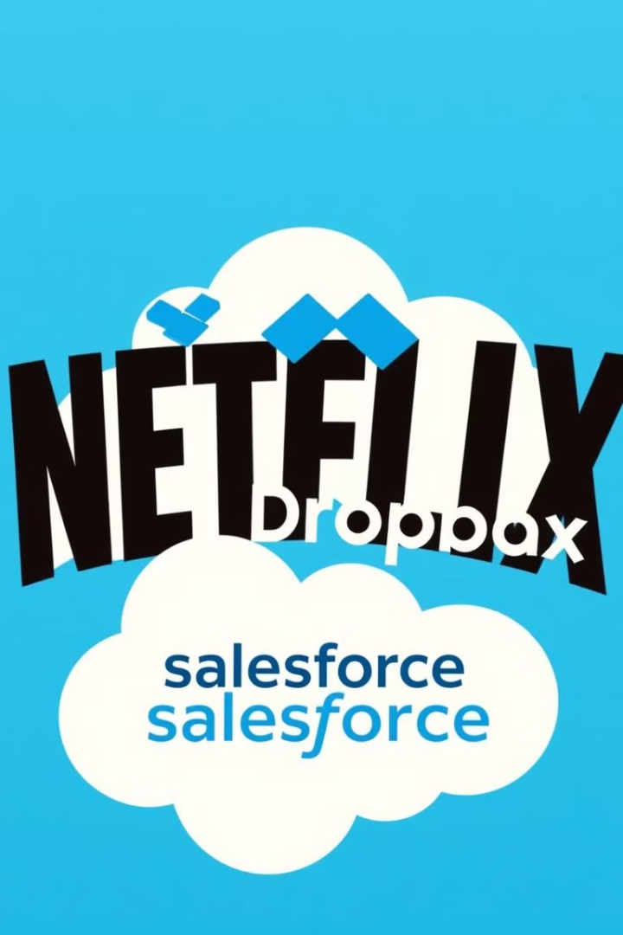
Real-World Cloud Examples
Netflix
Dropbox
Netflix uses AWS for streaming services. Scalability and reliability are enhanced.
Dropbox relies on cloud storage. Data access and collaboration are improved.
Salesforce
Salesforce delivers cloud-based CRM solutions. Customer relationship management is streamlined.

Slide 8

The Future of Cloud Computing
1
AI Integration
Cloud platforms will increasingly integrate AI. Data analysis and automation are enhanced.
2
Serverless
Serverless computing will gain traction. Applications can be built without server management.
3
Edge Computing
Cloud services will extend to the network edge. Data processing latency is reduced.

